Slide 1
Chapter 7 Handling of Text Files

Slide 2

Reading Content from Text Files
7.1
Programs often require users to input information. We have learnt about using the input() function in Python to obtain information input by users.

Slide 3
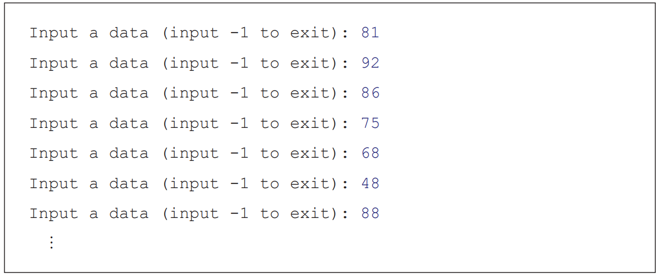
Reading Content from Text Files
7.1
However, every time when the program is run, users need to input pieces of information one by one, until they input a specific string (e.g. -1) for exiting the program.

Slide 4

Reading Content from Text Files
7.1
Other than receiving the information directly input by users, Python programs can also obtain information from plain text files (e.g. files in TXT, CSV or JSON format).
Therefore, when the program has a large number of inputs or outputs, it is more convenient to read the content from or write the content to text files.

Slide 5
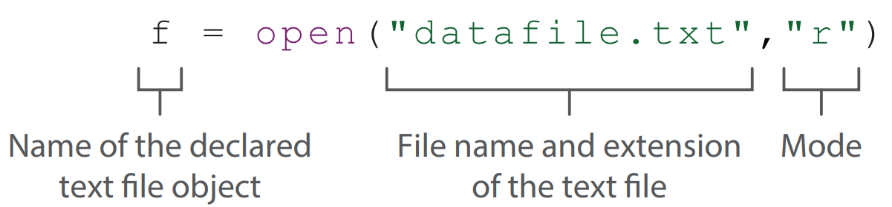
Opening text files
A
In Python, the most important function for handling text files is the open() function. This function requires two parameters: file name and extension of the text file and the mode.

Slide 6
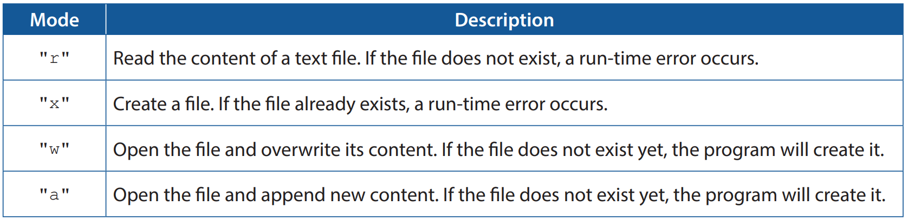
Opening text files
A
There are four modes for opening a file:

Slide 7
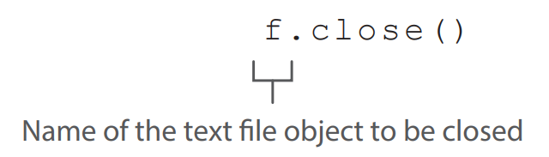
Opening text files
A
After completing file operations, remember to use the close() function to close the file.

Slide 8
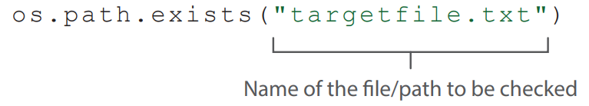
Checking whether a text file exists
B
If the file to be opened does not exist, a run-time error occurs in the program.
To avoid this, we should check whether a file exists before trying to open it. We can import the "os" library and use the path.exists() function to check whether the file or the path exists.

Slide 9
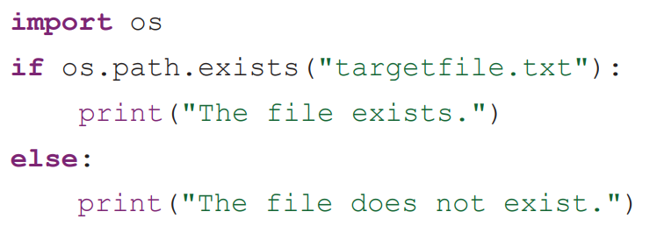
Checking whether a text file exists
B
This function returns a Boolean value: it returns True if the file exists; otherwise it returns False.

Slide 10
Reading text files
C
Complete Lab 7.1 on P.278 of the textbook.

Slide 11
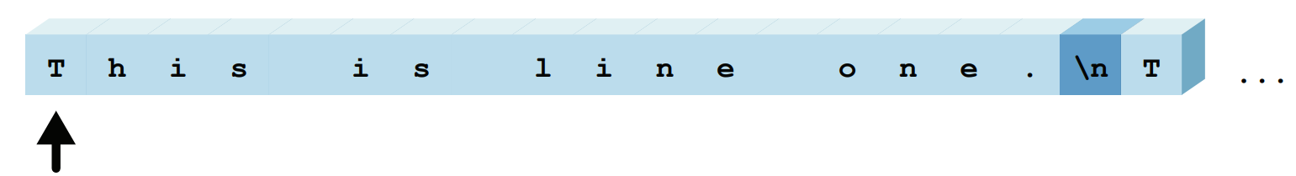
Text file streaming
D
Python treats content in a document as continuous character streams.
When a document is opened, the system generates a hidden pointer to indicate the position being read at the moment, i.e. point to the first character.

Slide 12
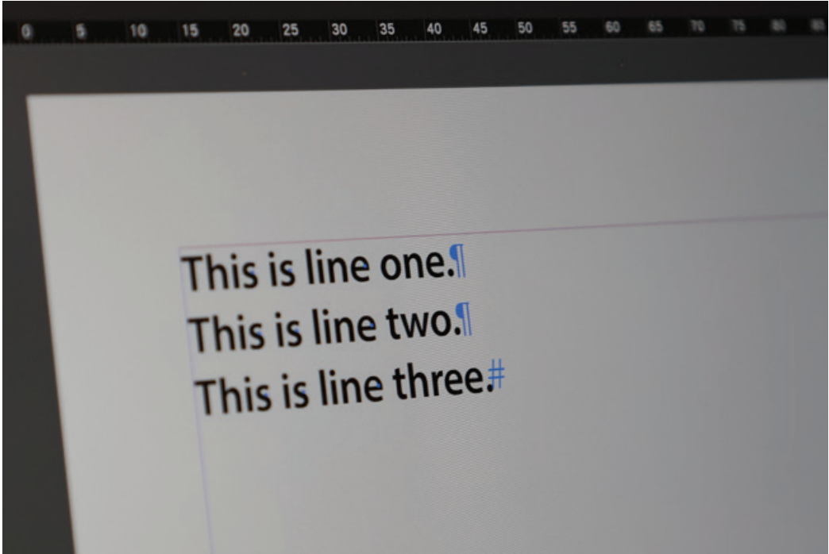
Text file streaming
D
In text files, there are some special characters for controlling the formats of printing and display. Usually such characters are not shown in the document editor, but they are still stored in the text files:
Line Feed (LF) character “\n” is stored at the end of every line;
End Of File (EOF) character “EOF” is stored at the end of the text file.

Slide 13
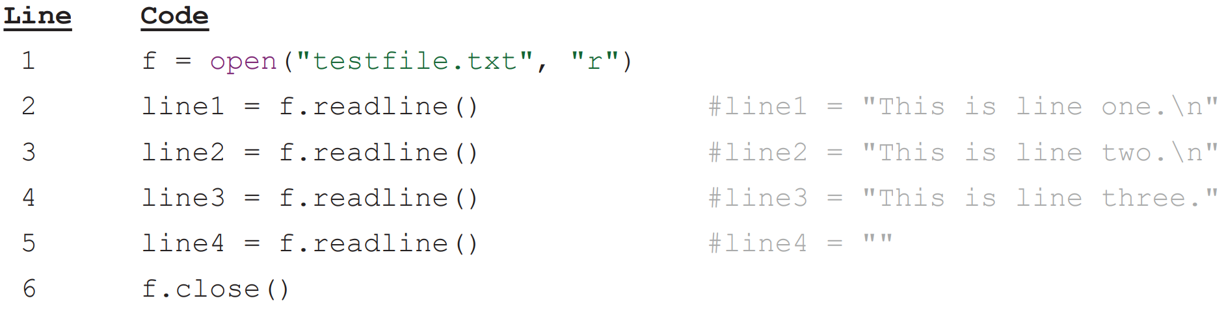
Text file streaming
D
In Python, the read() function is used to read a document until it detects the EOF; while the readline() function is used to read a document until it detects a \n or reaches the end of the file. Take the following Python program as an example:

Slide 14
Text file streaming
D
1. When the document is opened, the hidden pointer points to the first character.

Slide 15
Text file streaming
D
2. The readline() function in the second line starts reading the document until the hidden pointer moves to the character after the \n character.

Slide 16
Text file streaming
D
3. The readline() function in the third line starts reading the document from the position where the hidden pointer last stopped, until the hidden pointer moves to the character after the \n character.

Slide 17
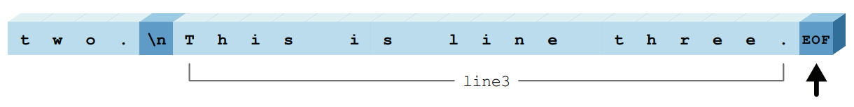
Text file streaming
D
4. The readline() function in the fourth line starts reading the document from the position where the hidden pointer last stopped. Since no \n is detected by the time the function reached the end of file, the function stops reading.

Slide 18
Text file streaming
D
5. The hidden pointer reaches the end of file character. The readline() function in the fifth line returns an empty string.

Slide 19


7.1
1. Shirley has received the following text file “NewMember.txt”. The document stores the list of new members who join the Table Tennis Club this year, and each line shows a member’s name:
She writes the sub-program newMemberList() to save the new members’ names in the document to list member, and then return this list:

Slide 20
7.1
Complete the following sub-program newMemberList() in Python.
def newMemberList(): member = [] f = open("NewMember.txt", "r") name = f.readline() while ________________ : member = member + [name] name = f.readline() f.close() return member

Slide 21
7.1
◣ Solution
len(name) > 0

Slide 22
String Processing
7.2
Same as numbers (integers and floats), strings are one of the most frequently processed data types in Python. In this section, we will learn more ways to process strings in Python.

Slide 23
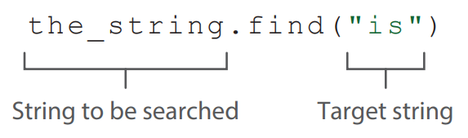
Searching strings
A
Python provides the find() function for us to search a string for the target string, and then return the search result:
If the target string is found, the function returns the index of its first occurrence;
If the target string is not found, the function returns -1.

Slide 24
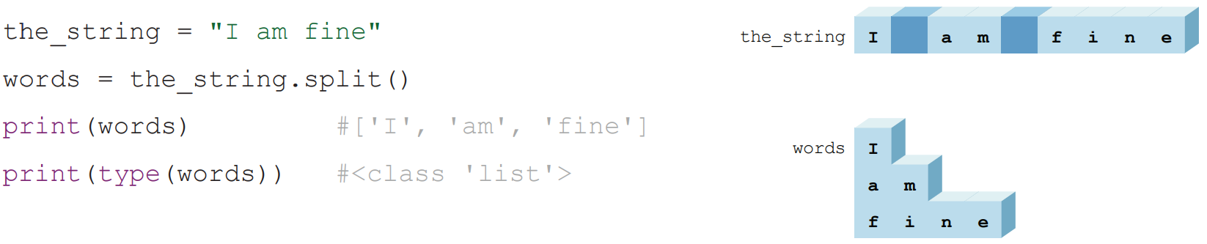
Splitting strings
B
An English sentence is formed by multiple words, which are separated from one another by whitespaces.
We can use the split() function to split words into list items, and then the function returns this list. The following is a sample Python program:

Slide 25
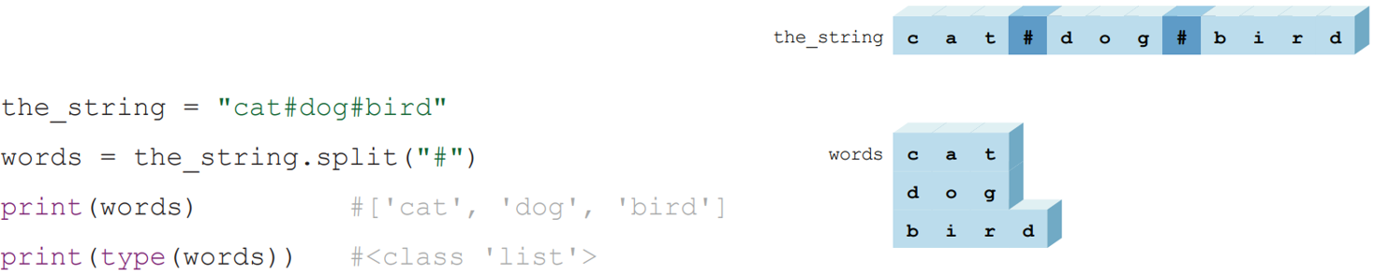
Splitting strings
B
Apart from splitting strings by the default delimiter (i.e. whitespaces), we can specify another delimiter. The split() function uses the input parameter as the delimiter.
Sample Python grogram:

Slide 26
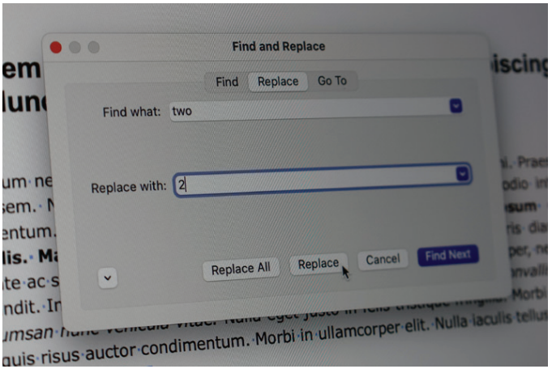
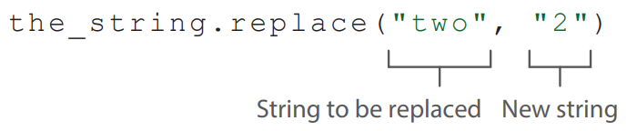
Replacing strings
C
We often have to update the content of text files. Python provides the replace() function, which returns the new string after the specified string has been updated.

Slide 27
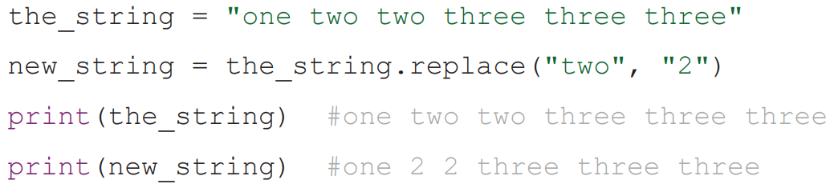
Replacing strings
C
Sample Python program:

Slide 28
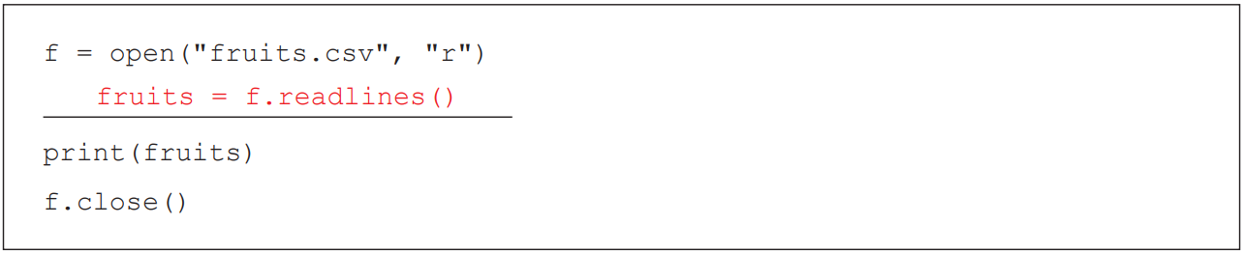
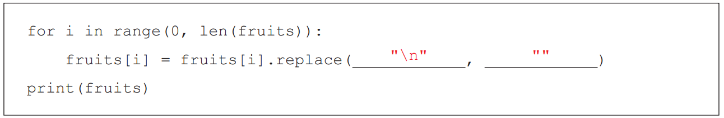
7.1
Complete Checkpoint 7.1 on P. 286 of the textbook.
a)
b)

Slide 29
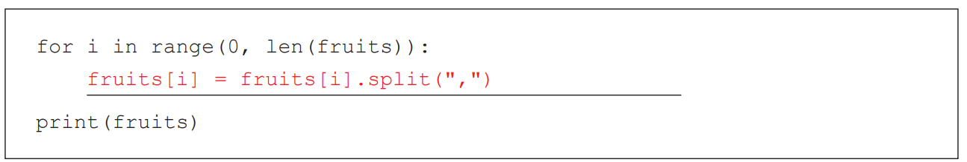
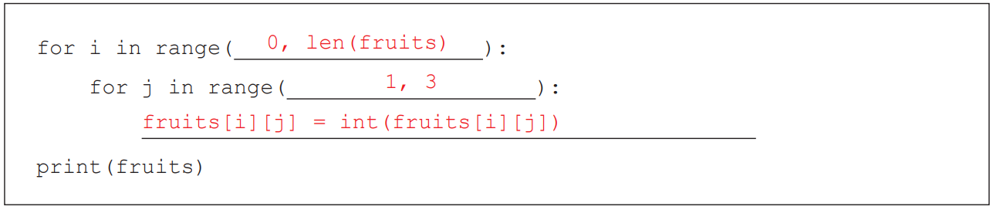
7.1
c)
d)

Slide 30
Writing Content into Text Files
7.3
Complete Lab 7.2 on P.288 of the textbook.

Slide 31
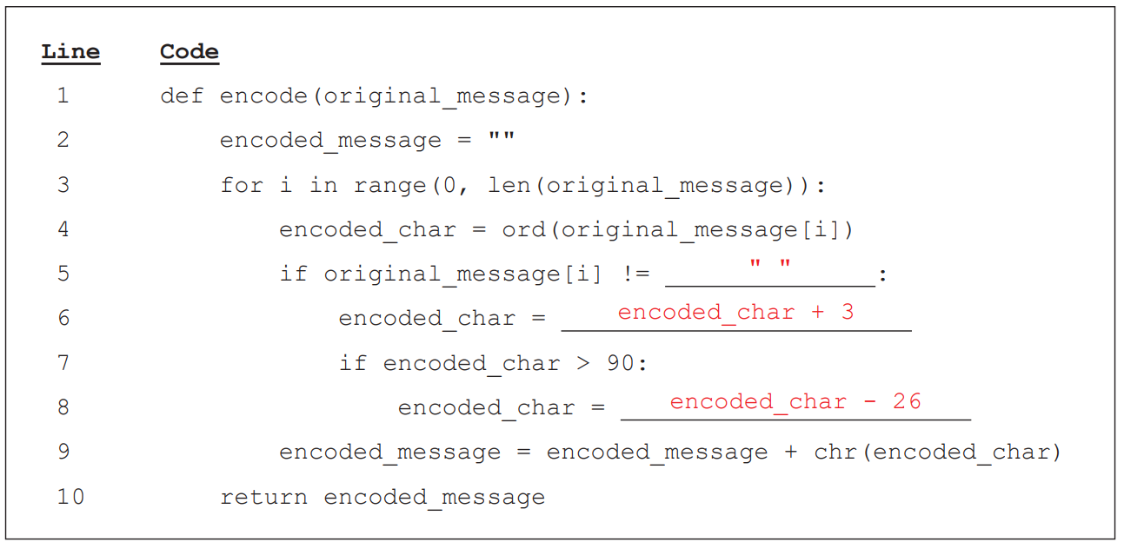
7.2
Complete Checkpoint 7.2 on P. 289 of the textbook.
a) LW LV D QLFH GDB
b)

Slide 32
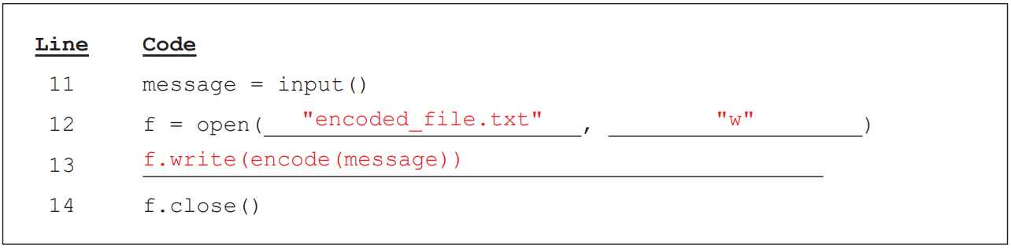
7.2
c)
d) NY NX F SNHJ IFD
e) Change the code in line 6 to encoded_char = encoded_char + X

Slide 33
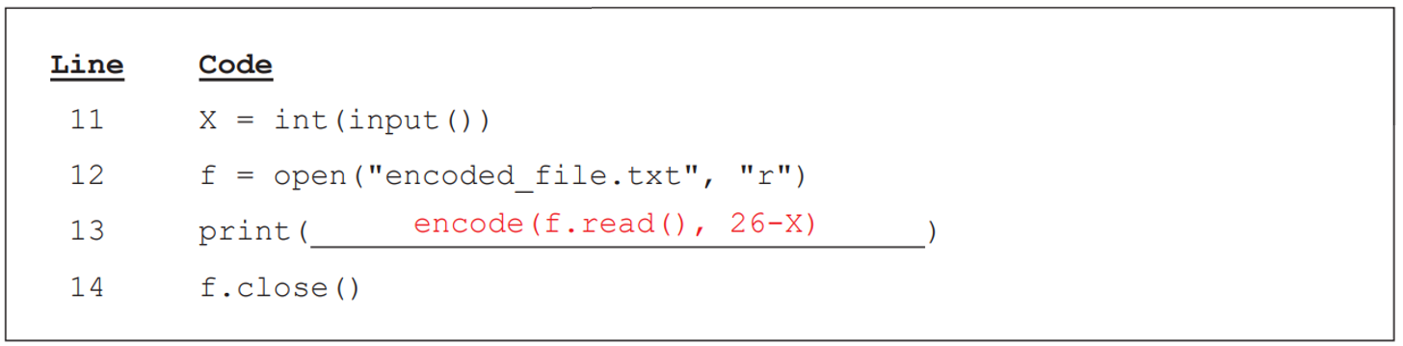
7.2
f)

Slide 34
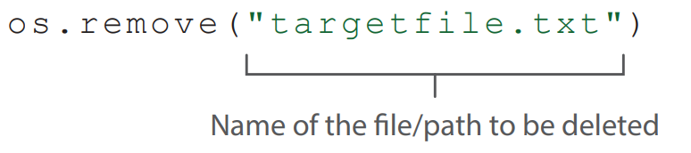
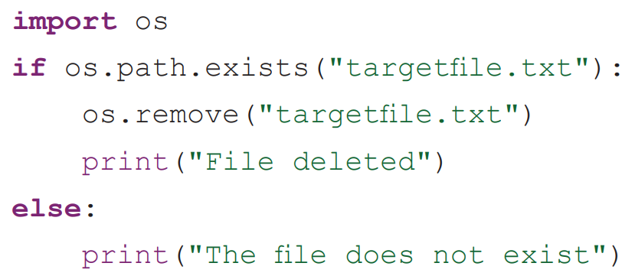
Deleting Text Files
7.4
We can use the remove() function in the “os” library to delete files: Similarly, to avoid run-time errors, we should check whether a file exists before trying to delete it.

Slide 35
Updating Records in a Text File
7.5
Unlike internal data (stored in variables) of a program, data stored in external files does not disappear even when the program ends or the computer shuts down.
This chapter will show you how to update records in a text file.

Slide 36
Updating Records in a Text File
7.5
By referring to the format of data storage in a database, we can store and display data in rows and columns.
Each column is a field;
Each row is a record.

Slide 37
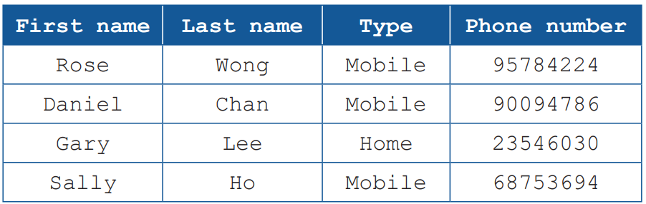
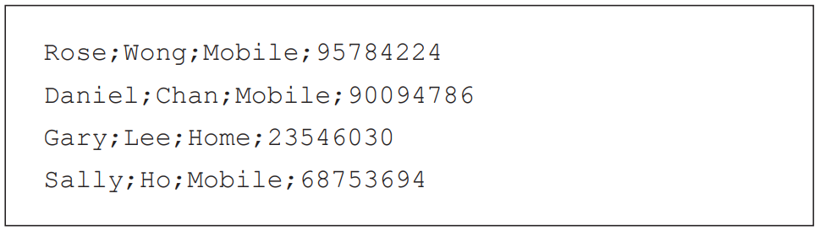
Updating Records in a Text File
7.5
Take the following table that stores contact information as an example:
Assume that we store the above data in a text file “phonebook.txt”, each line represents the record of a contact and each field is delimited by a semicolon. The format is as follows:

Slide 38
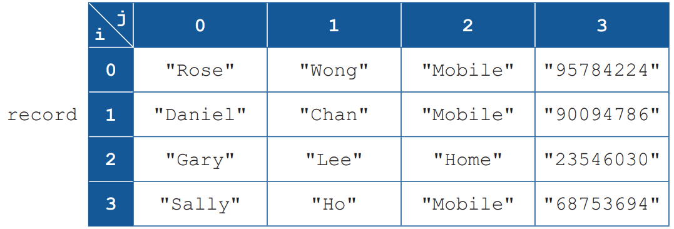
Loading records
A
To update records in a text file by a program, we need to load the data into the program first, and then store and process the data in a two-dimensional list.
The following two-dimensional list record displays the contact information in the text file “phonebook.txt”:

Slide 39
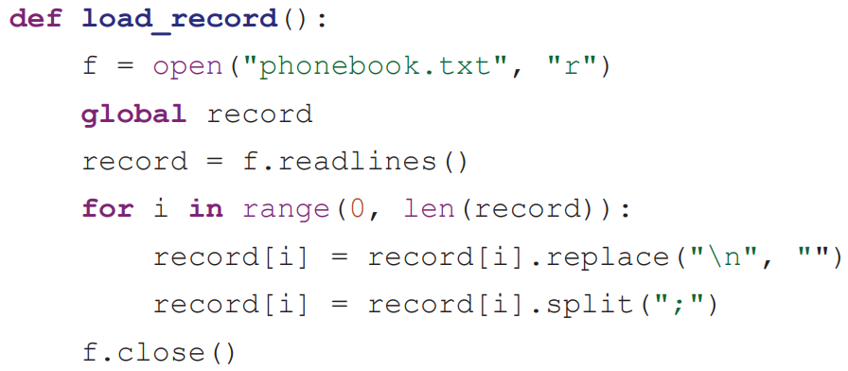
Loading records
A
The following sub-program load_record() saves the contact information in the text file to two-dimensional list record:

Slide 40
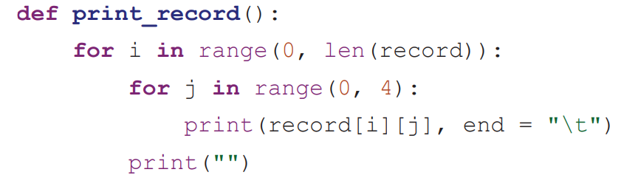
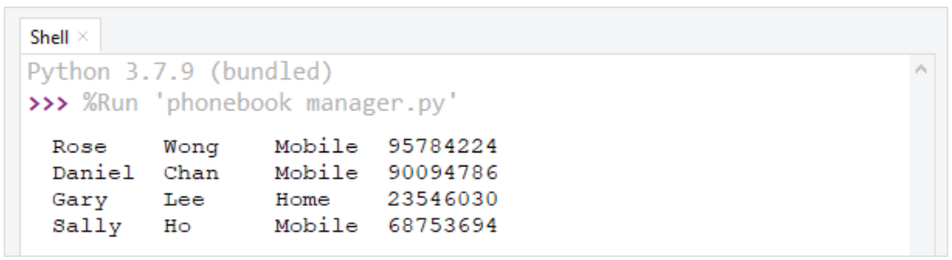
Loading records
A
The following sub-program print_record() print the items of two-dimensional list record in table format:
The following is the output in the shell after loading the data and calling the sub-program print_record():

Slide 41
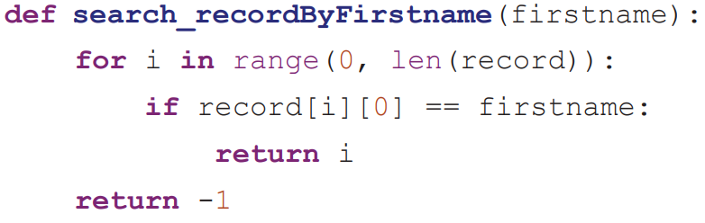
Searching for records
B
The following sub-program search_recordByFirstname(firstname) uses linear search to search for the existence of the target name firstname in the list, and returns the search result:

Slide 42
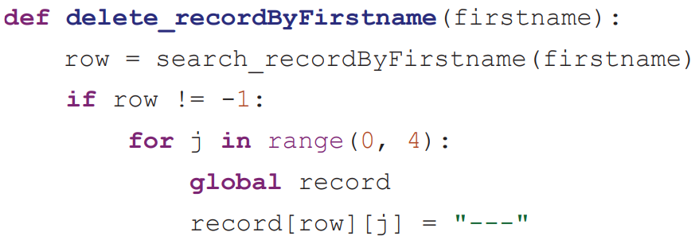
Deleting records
C
The following sub-program delete_recordByFirstname(firstname) replaces the whole record of the target name firstname with the string “---” to indicate that the record has been deleted:

Slide 43
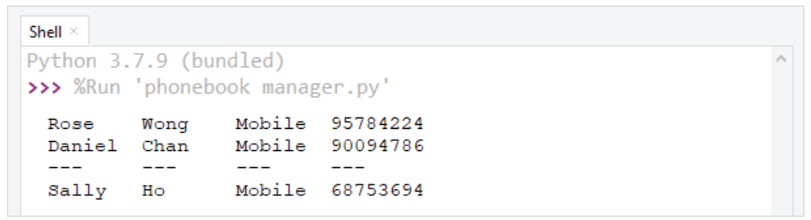
Deleting records
C
The following is the output in the shell after loading the data and calling the sub-programs delete_recordByFirstname("Gary") and print_ record() sequentially:

Slide 44
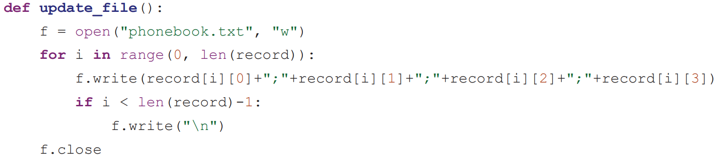
Updating a Text File
D
The following sub-program update_file() writes all the items of two-dimensional list record to the text file once again in a specific format:

Slide 45
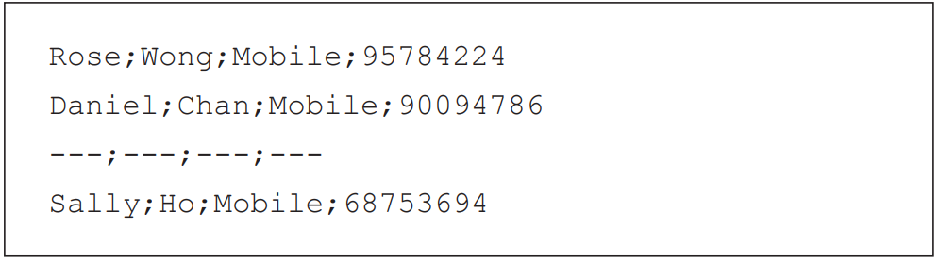
Updating a Text File
D
The content of the updated text file “phonebook.txt” is as follows:

Slide 46
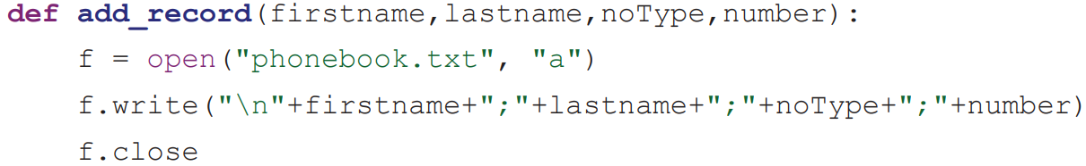
Adding records
E
The following sub-program add_record(firstname,lastname,noType,number) appends the record of a contact to the text file.

Slide 47
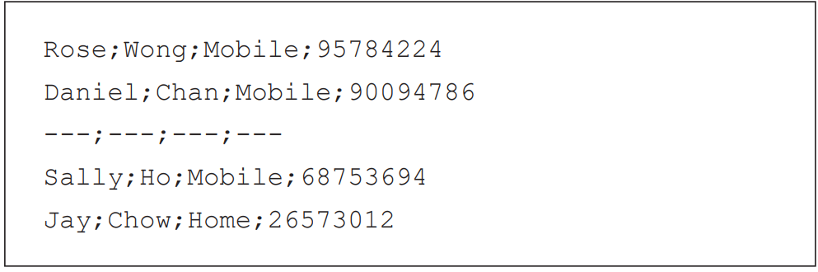
Adding records
E
The content of the text file “phonebook.txt” after calling the sub-program add_record("Jay","Chow","Home","26573012") is as follows:

